Slide 1
PL-600 Data Modeling

Slide 2
Agenda
Data model influences
Data model strategy
Data types
Data relationships

Slide 3
Solution Architect role in data modeling
Lead the data model design effort to establish a high-level data architecture for the project
Establish a data model that can be extended by the individual design teams and communicate the design with the teams
Review and provide feedback as the data model evolves during detail design of solution features

Slide 4
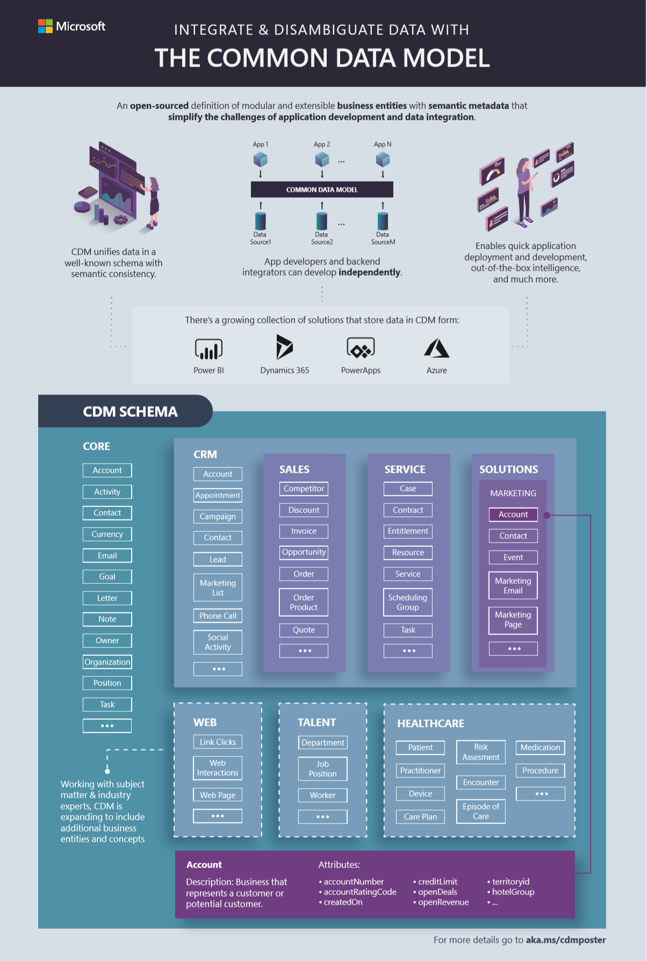
Common Data Model (CDM)
A shared data model allows applications and data integrators to interoperate via a unified definition of data
CDM includes a rich metadata system with standard tables, relationships, hierarchies, traits and more
Originated from Dynamics 365 / CRM apps, open-sourced in GitHub with over 260 standard tables
Multiple systems and platforms implement CDM today
Internal and external partners including CDS, Power BI dataflows, Azure Data Services, Informatica and more
Notes:
Ecosystem of internal and external partners contributing to the effort, including industry-specific concepts
https://github.com/Microsoft/CDM

Slide 5

Industry Specific CDM Extensions
Customers
System Integrators
SIs: Package together ISV solutions and customize to deliver
AppSource
AppSource: Delivery mechanism for Industry Solutions and/or Apps and Microsoft Solution Accelerators
3rd Party Connectors
ISV
ISV
ISV
ISV
ISV: Horizonal ISVs extend solutions
Industry ISV
Industry ISV
Industry ISV
Industry ISV Solution: may stand alone or OEM other industry or horizontal apps
Microsoft Industry Solution Accelerator
Microsoft Industry Solution Accelerators: package of data model, relevant business processes, Power BI dashboards, and sample data
Microsoft Industry Standard CDM
Expanding to strategic industries, including, Healthcare, Non-profit ,Education, Finance and Retail
https://aka.ms/cdmindustry
Notes:
Not sold as 1st party
Open source

Slide 6
Choosing how to store/access data
Microsoft Dataverse– For transactional data your apps are going to consume and manipulate
Azure Data Lake – Good for data from other systems, read focused, and brought into a common data model structure
Connectors – Good for leaving data where it is and accessing other services that make their data available

Slide 7
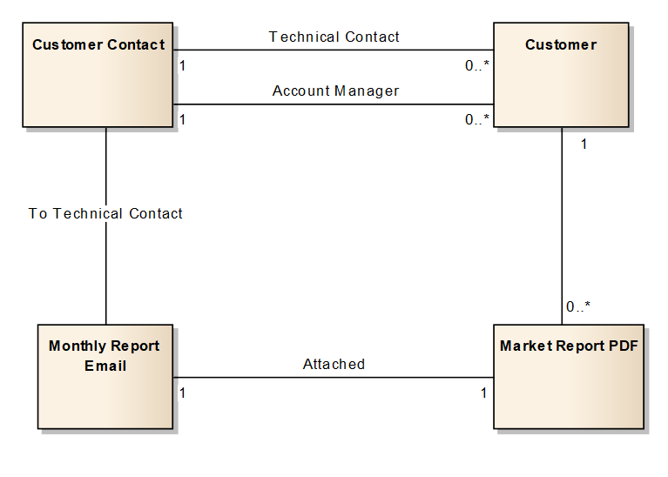
Logical Data Modeling
Logical data model diagrams depict the flow of data in a solution without worrying about the physical implementation

Slide 8
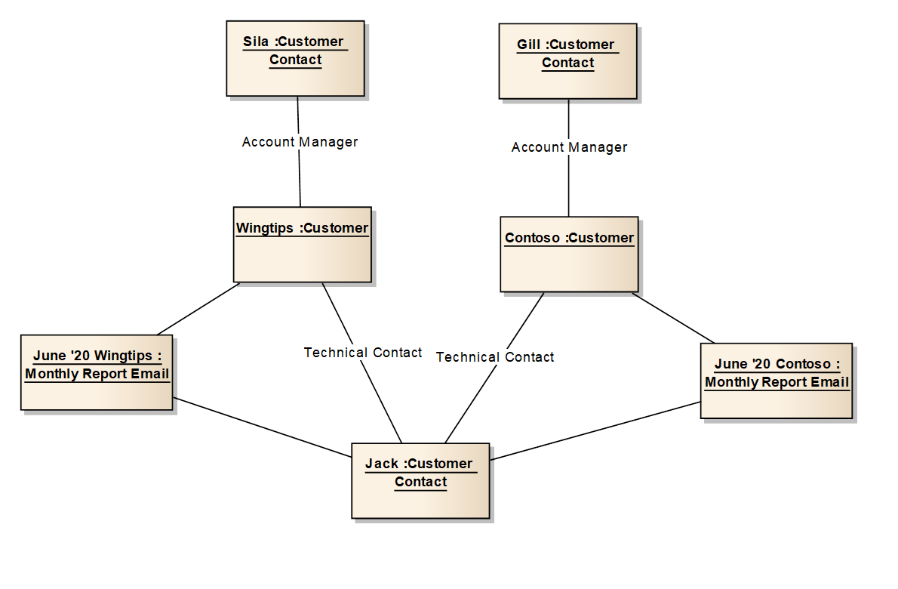
Using Object Diagrams
Notes:
object diagrams– it really shows you want you know and more importantly what you don’t. These have to be done in modelling sessions with domain experts.

Slide 9
Data Modeling Strategies
Start with the core tables and relationships
Avoid desire to over normalize
Start with the end in mind, what do you need to report on
What data is required to support AI
Know the needs today, in 6-12 months, and in the future
A proof of concept is valuable, Microsoft Dataverse makes it easy
Notes:
Start with core – too often teams get sidetracked with the whole problem it’s a lot easier to solve small parts of the challenge and then look at it holistically later
Over Normalization – Teams with people with a strong data architecting background tend to try to build a Microsoft Dataverse data model like they would a traditional SQL database, often times working with them to see the cause and effect of relationships in the user experience can help them understand the goal. For example trying to implement inheritance when Microsoft Dataverse doesn’t support true inheritance
Needs today – Microsoft Dataverse is great at being incrementally build using an agile process, but having some insight into the future helps lay the foundation – just don’t get stuck trying to nail down every future requirement you can think of
Proof of concepts – Microsoft Dataverse makes it easy to create a test org, try a model, throw it away and try again. Sometimes even challenging two teams with the same data modeling problem can produce useful results

Slide 10
Data Modeling Influencers
Security requirements
User experience
Data location and retention policies
Self service reporting needs
Roadmap
Existing systems
Localization
Balancing Influencers
Notes:
Security Requirements – always push for simplification, but these can drive requirements onto the data model
User Experience – it’s easy to forget that as we add normalization and relationships we create new constructs users need to navigate to be successful
Data Location / Retention - Not all data is allowed to be stored, often times data from services can’t be cached, companies have internal policies that govern use of data, some data is protected by government laws and also has specific requirements for storage e.g. PII, credit card numbers etc.
Self Service Reporting – if it takes a data architect to navigate the data model, chances are many of the tools from Power BI and Export to Excel will be less valuable to the user. Most self service features of Microsoft Dataverse allow navigation of one level of relationships
Existing systems (legacy or not) - data?
Existing systems - UX?
Multi-region, multi-lingual, multi-currency requirements?

Slide 11
What are the key things to consider when choosing table options?
Classroom discussion

Slide 12
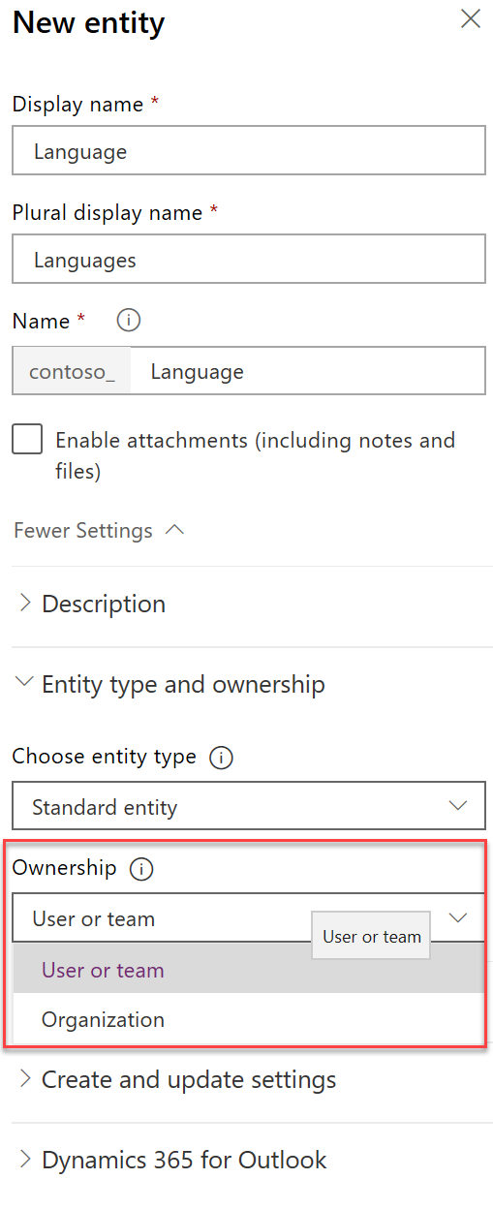
Row Ownership
All rows have an owner
Organization
Supports access levels
Row owned by organization
All or nothing access
User/Team
When in doubt, choose User/Team
Organization is great for reference data

Slide 13
Pros and cons of using Custom Activity
A non-profit created a fundraiser application and modeled the donation table as a custom activity
Task
Contact
Donation
Email
Notes:
Pro
Shows up in list with other activities
Could be rolled up with other activities
Could create a donation on any table that supports activities
Cons
Not able to configure security different than any other activity
You can’t control which tables are related to a donation (other than by limiting what tables are in the App module)

Slide 14
Column type considerations
Yes/No – Ensure you never need more choices
File and Image – allows storing file and images inline in Microsoft Dataverse
Customer – Can be either contact or customer
Lookup/Choice – make sure you choose the best one
Date/Time – Make sure you choose the appropriate behavior (local, time zone independent, date only)
Number columns – many to choose from, choose wisely
Notes:
Choose all of these wisely, but regarding number columns, keep the future in mind…does the column participate in automation as expected? Calculated or rollups too? Once a type is chosen, you cannot change it.

Slide 15
Choice vs. Lookup
Choice
Only stores label and value
Lookups
Can store other data
Localization built-in
Filtered by developer script
Treated as solution component
No built-in way to retire
UX works to about 200 items
Stores as whole number
You build localization
Filter by views and security
Treated as reference data
Supports inactive state
UX scales to lots of items
Stores as table reference
Notes:
Storing other data allows access when running workflows, or other customizations that reference the data. For example a related property can be used if a check condition
By being a solution component, choices handle merge resolution by prefixing the value with the publisher prefix, optionsets require system customizer access, lookups can be changed by the non customizer if granted permission
UX for choices is ideal for small quantity but doesn’t work well for large, lookups provide search type features not available on choices
Dependent optionsets vs dependent (filtered) lookups
List of countries is a very good debatable topic in this instance
Another alternative to consider is a simple text column using the type-ahead lookup

Slide 16
Storing file and image data
Microsoft Dataverse
SharePoint
Azure Storage
Good for upload and reference
Security follows row permissions
Limited by size
Good for collaboration
Security follows SharePoint permissions and is not synchronized with Microsoft Dataverse row permissions
Good for archiving and external access
Standalone security but can granted for small periods of time based on link generated for consumption
Can handle really large files

Slide 17
Calculated vs. Rollup columns
Calculated
Calculated on retrieve of row
Read only
Row columns and parent columns
Can include rollups in calculation
No OOB calculated columns
Rollup
Value stored on row, scheduled update/on-demand
Read only column
1:N only, columns on child rows
Can rollup calculated columns
Can use hierarchy of related rows
Can filter across related tables
Notes:
You can rollup "simple" calculated columns, e.g. calculated columns that include non-deterministic functions cannot be rolled up
Have a discussion about the pro/con of calculated column based on it being read only –and only loaded on retrieve

Slide 18
Avoiding Common Data Modeling Issues
Too many tables, too many columns
Think of the users!
Use the tools! Quick view forms instead of repeating columns
Avoid Yes/No, if there might be more
You are stuck with column formatting forever
Don’t build out parts of the data model you don’t plan to use
Notes:
Yes/No - True / False, but then you realize you have to store Unknown vs. not provided
In the New admin experience Column Formatting is presented as different column types
Too many tables – probably over normalized
Too many columns – probably should have been a separate table

Slide 19
Wrapping up
A good data model is essential as it forms the foundation of what you build your apps on
Problems with your data model are much harder to correct once apps have been composed using the model

Slide 20
Group exercise: Design a data model
Evaluate needs
Sketch your data model
Notes:
You are building a solution for Fabrikam to track visitors to a showroom and manufacturing site. Some of the visitors are potential purchasers and some are just there to see the magic of the robots working.

